Slide 1
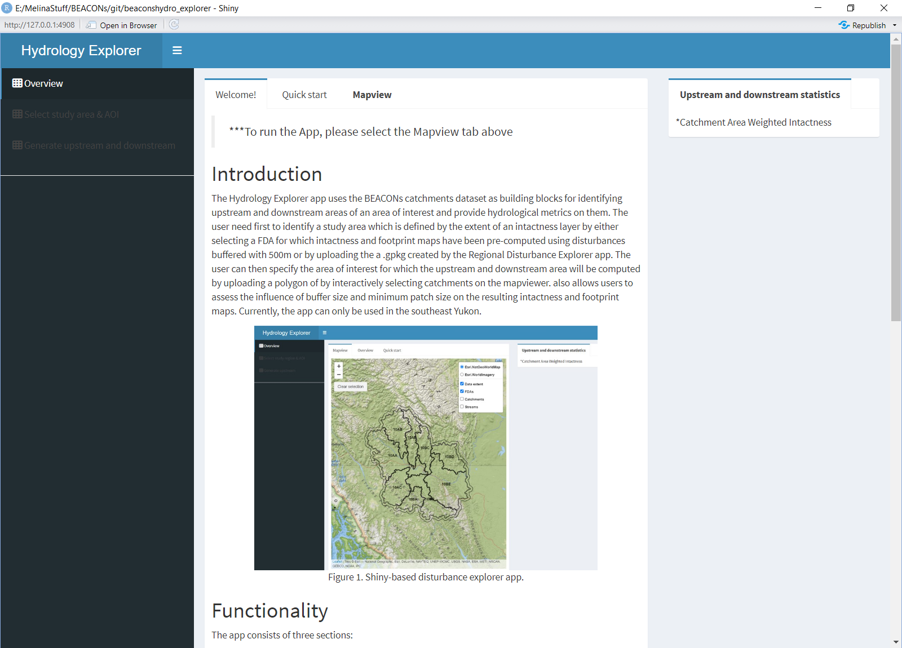

Slide 2
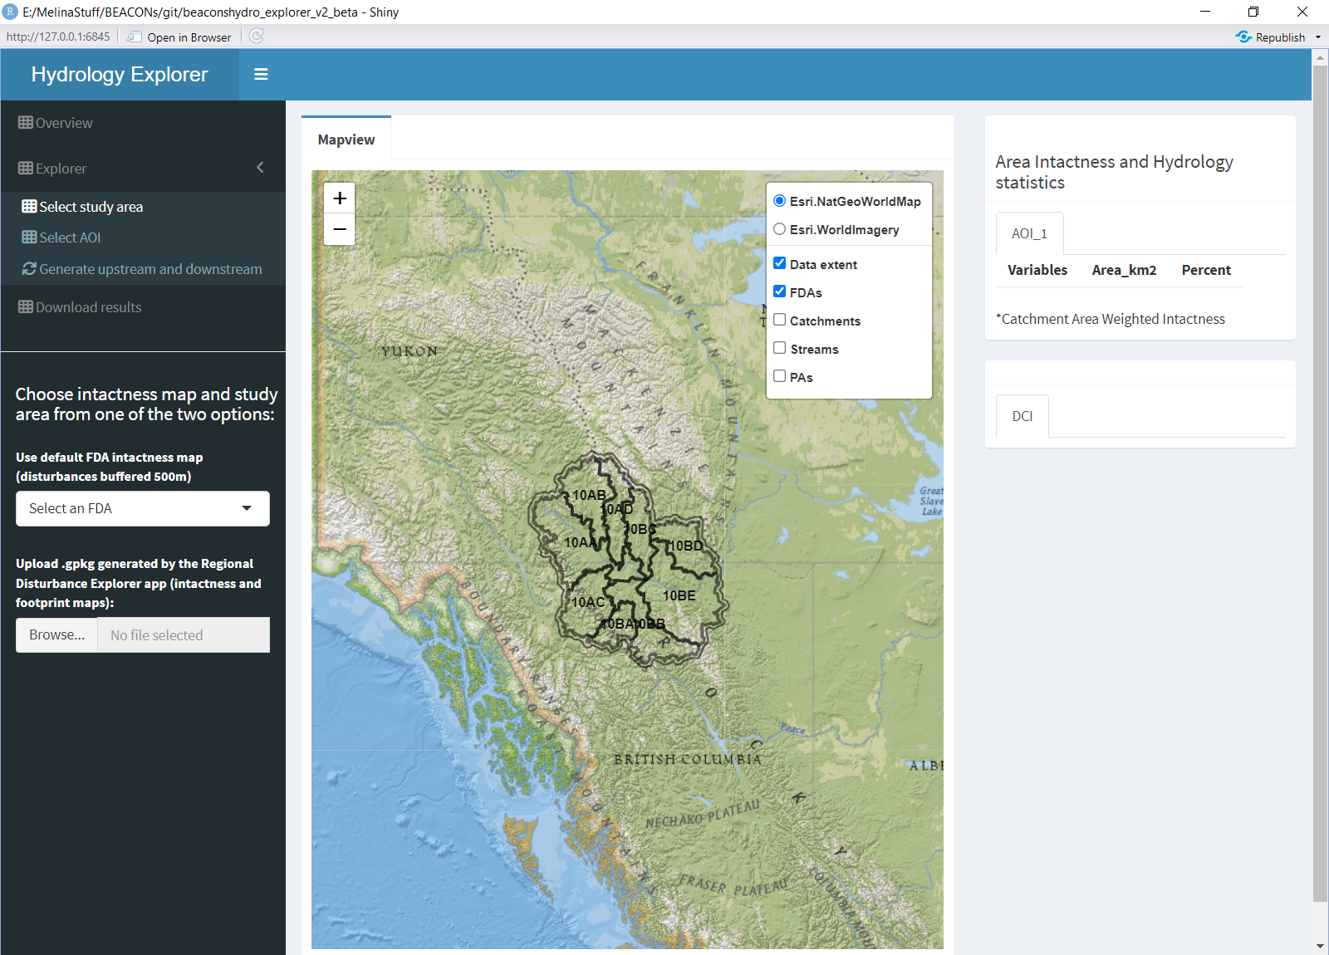
Select your study area
Select a FDA for which intactness and footprint were generated using 500m buffer around linear and areal polygons
Upload your study area by using a .gpkg generated by the Disturbance Explorer app

Slide 3
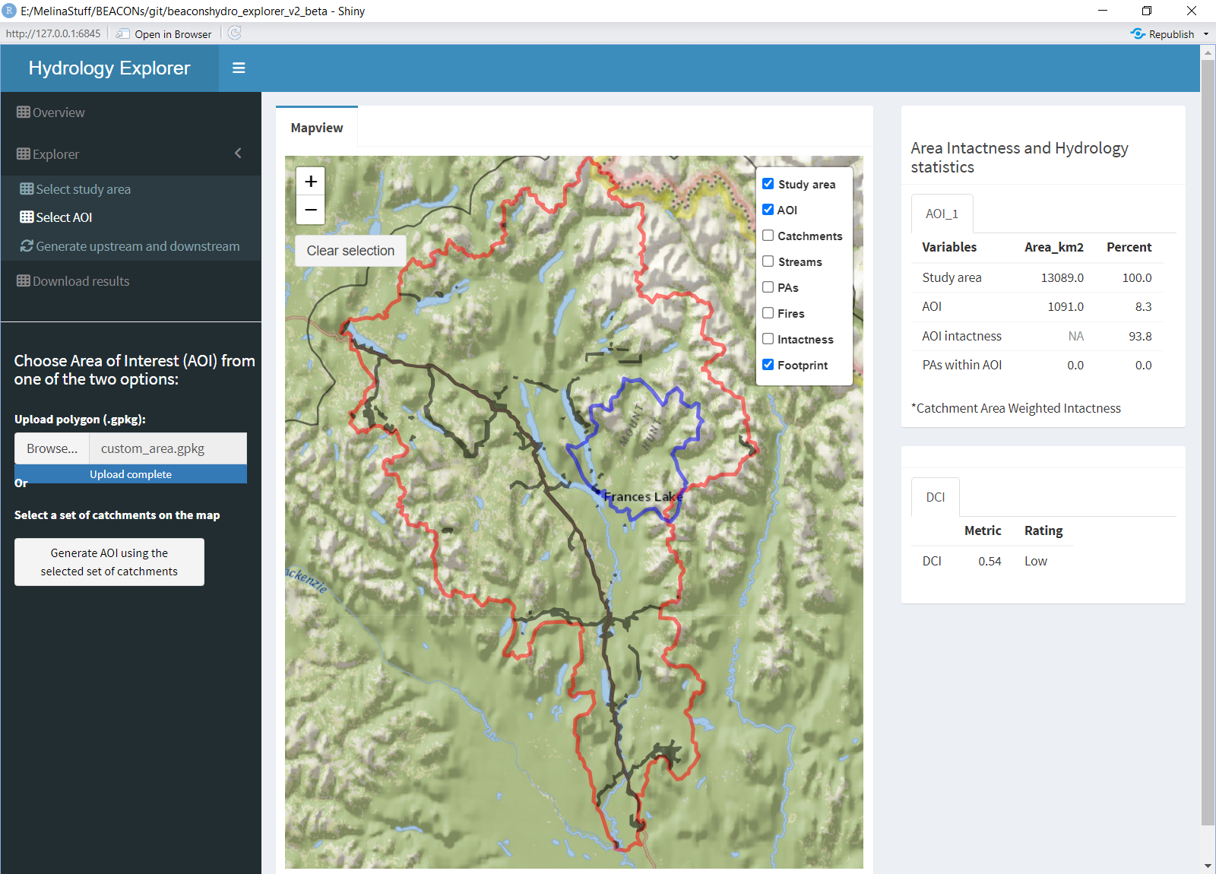
Select your Area of Interest (AOI)
Upload a polygon (.gpkg) that represent your AOI

Slide 4
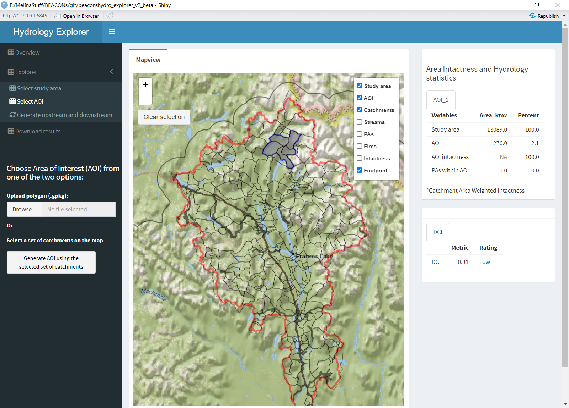
Make sure your catchments layer is turned ON
Select your Area of Interest (AOI)
Generate your AOI by selecting manually the catchments . Make sure the catchment layer is turned ON on the Mapview tab

Slide 5
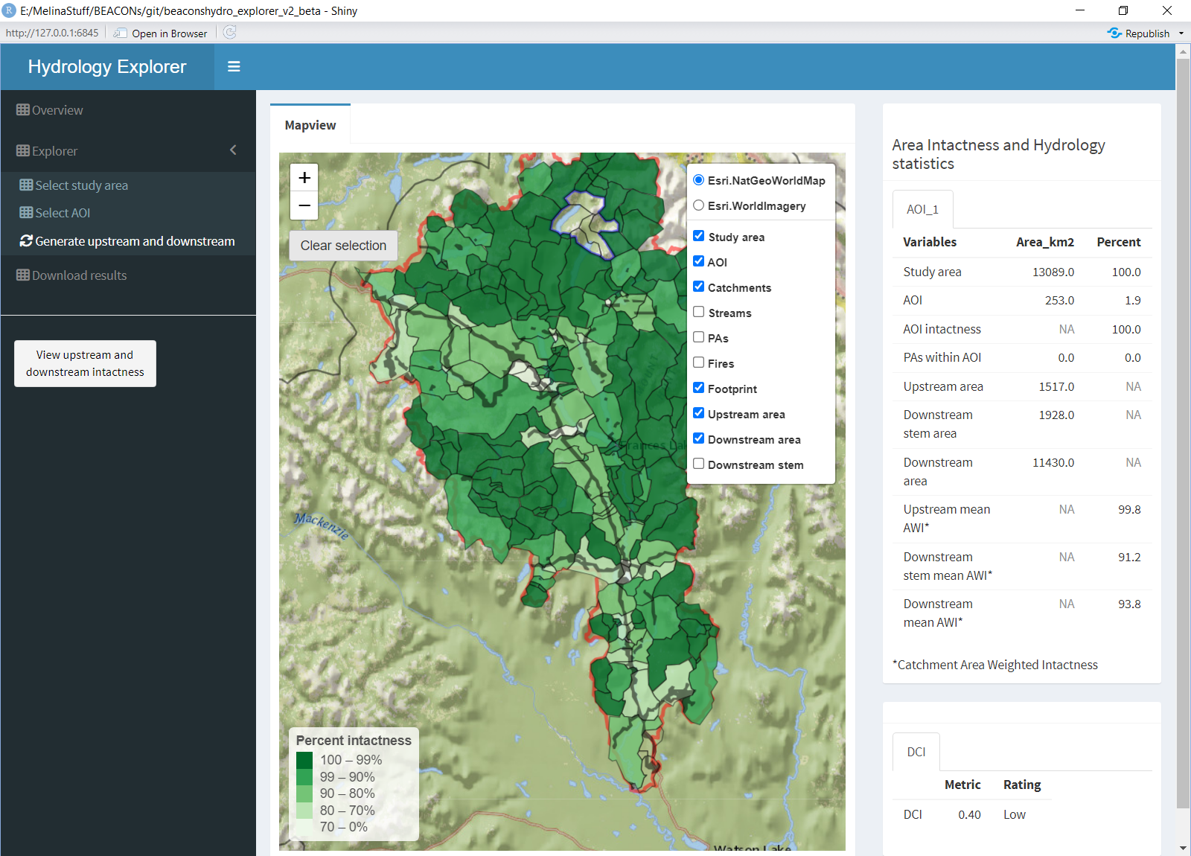
Extract upstream and downstream statistics related to the study region and Area of Interest
Generate the map illustrating upstream and downstream intactnee percent per catchment.

Slide 6
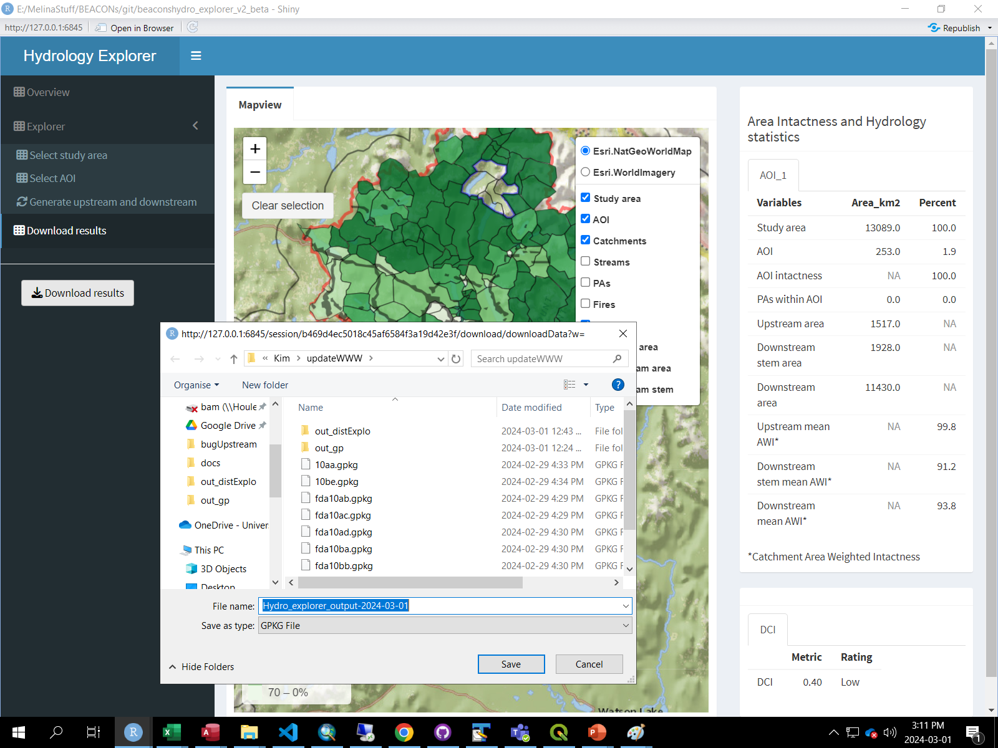
Download a .gpkg representing the catchments overlapping the study region, the identification of the position of the catchmentrelated to the Area of Interest (upstream or downstream) and their respective intactness percent.

